Slide 1
YOLO Realtime parking status
DA Review -1

Slide 2


DATA SET CHOSEN - Data for Yolo v3 kernel
https://www.kaggle.com/aruchomu/data-for-yolo-v3-kernel/download
Kaggle is the source website which is used to download the data set for object detection in real-time.
The yolo dataset contains sample images, fonts, class names and weights.

Slide 3
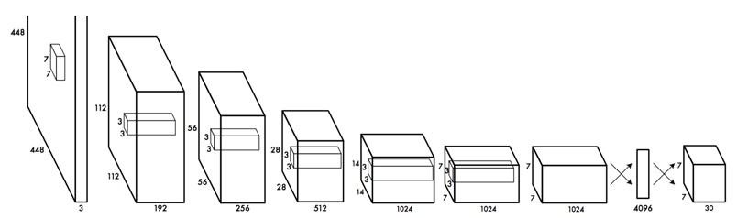
Outcome of the data analysis
A a single neural network is applied to the full image. This network divides the image into regions and predicts bounding boxes and probabilities for each region. These bounding boxes are weighted by the predicted probabilities.
The processing of each image after running the YOLO algorithm returns coordinates of the bounding boxes of each detected object. It gives ordered pair (x,y) coordinate and then gives a (w,h) which is width and height of the bounding box. The object detection is limited to four wheelers by specifying the coco labels for this application.

Slide 4
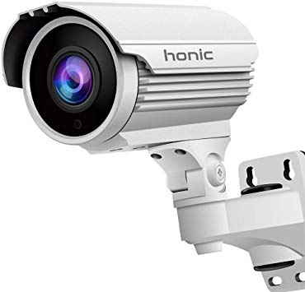
USERS and USE of outcome
The python script would be developed to detect location of cars in real-time. The continuous steam of real-time video will be processed as each image one by one using the YOLO weights
The centroid of each bounding box will be formed to use as conformation. The parking spots will be marked in the video frame as boundaries.
If a centroid enters the boundary of parking spot then it will update the parking status in the cloud database.

Slide 5

USERS and USE of outcome
The android application picks up the change in the database and changes the state in the app.
The result would be all the user who have the android application will be able to know real-time the status of all the parking spot and would not have to drive around looking for a parking spot.
This will also decrease the time taken for parking and the best part is it needs no additional hardware. The system can be implemented in existing CCTV cameras at the parking spot.

Slide 6
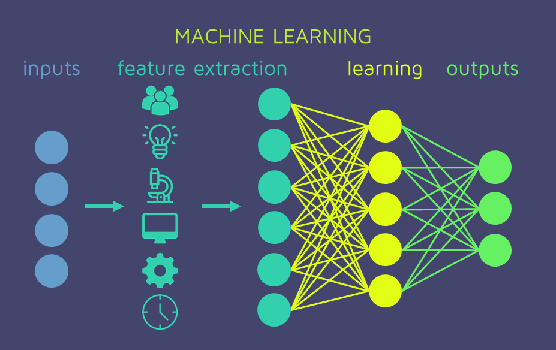
machine learning technique to be use
The algorithm applies a neural network to an entire image. The network divides the image into an S x S grid and comes up with bounding boxes, which are boxes drawn around images and predicted probabilities for each of these regions.
The method used to come up with these probabilities is logistic regression. The bounding boxes are weighted by the associated probabilities. For class prediction, independent logistic classifiers are used.

Slide 7
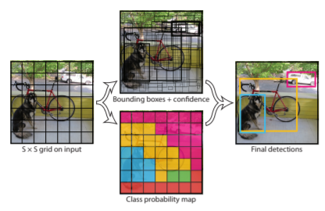
justification of technique
The rationale behind calling the system YOLO is that rather than pass in multiple sub-images of potential objects, you only passed in the whole image to the deep learning system once. Then, you would get all the bounding boxes as well as the object category classifications in one go.

Slide 8
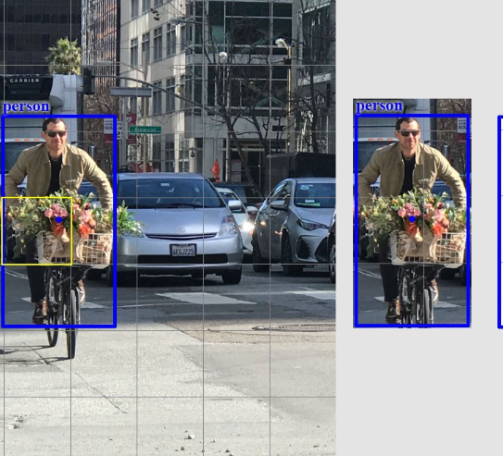
metrics for testing
For each grid cell,
it predicts B boundary boxes and each box has one box confidence score,
it detects one object only regardless of the number of boxes B,
it predicts C conditional class probabilities (one per class for the likeliness of the object class).
To evaluate PASCAL VOC, YOLO uses 7×7 grids (S×S), 2 boundary boxes (B) and 20 classes (C).

Slide 9

THANK YOU !

